Slide 1

GITHUB
Submitted by : Drishti Gupta
Branch : AIML
Roll No : 2322825
Submitted To : Mr. Devashish Sir

Slide 2
GIThub
GitHub is a developer platform that allows developers to create, store, manage and share their code. It uses Git software, providing the distributed version control of Git plus access control, bug tracking, software feature requests, task management, continuous integration, and wikis for every project Git Hub is a developer platform that allows developers to create, store, manage and share their code. It uses Git software, providing the distributed version control of Git plus access control, bug tracking, software feature requests, task management, continuous integration, and wikis for every project.

Slide 3
GIT COMMANDS
INITIALIZE :-
initialize a new git repositiory in working directory
ADD :-
add changes in working directory to staging area
COMMIT :-
save changes from staging area to local repository in Git
PUSH :-
upload local repository content to a remote. Eg. GitHub
CLONE :-
clone a repository from GitHub onto a local machine

Slide 4
SETUP steps :
Create a GitHub account :-
https://github.com/signup > enter details > confirm email
Install Git :-
Pre installed on linux and mac. https://git-scm.com/downloads
Check Git installation :-
On terminal (mac) or shell (window) or VS code (after VS code installation>tools menu>view>terminal
Install code editor (VS code) :-
https://code.visualstudio.com

Slide 5
Setting up a github account
1. Visit GitHub Website:
Open your web browser and go to GitHub's homepage.
2. Sign Up:
Click on the "Sign up" button located in the upper-right corner of the page.
3. Enter Your Information:
Username: Choose a unique username. This will be your public handle on GitHub.
Email Address: Enter a valid email address that you have access to.
Password: Choose a strong password. GitHub will indicate the strength of your password.
Click "Create account" after entering the above details.
4. Verify Your Account:
GitHub will send a verification code to your email address. Check your email, copy the code,
and paste it into the verification field on GitHub.

Slide 6

Homepage

Slide 7
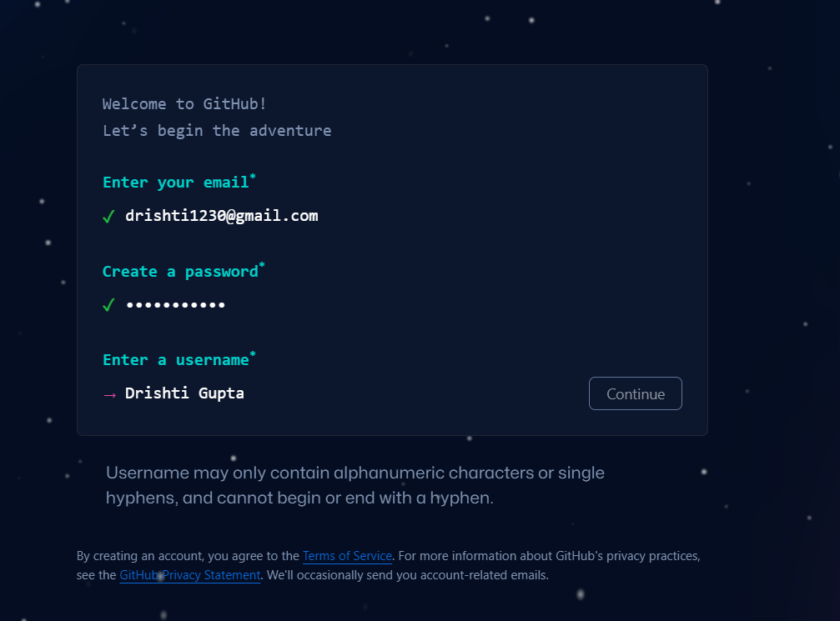
Steps :

Slide 8
My GITHUB PROFILE
Link : https://github.com/Drishti0430

Slide 9
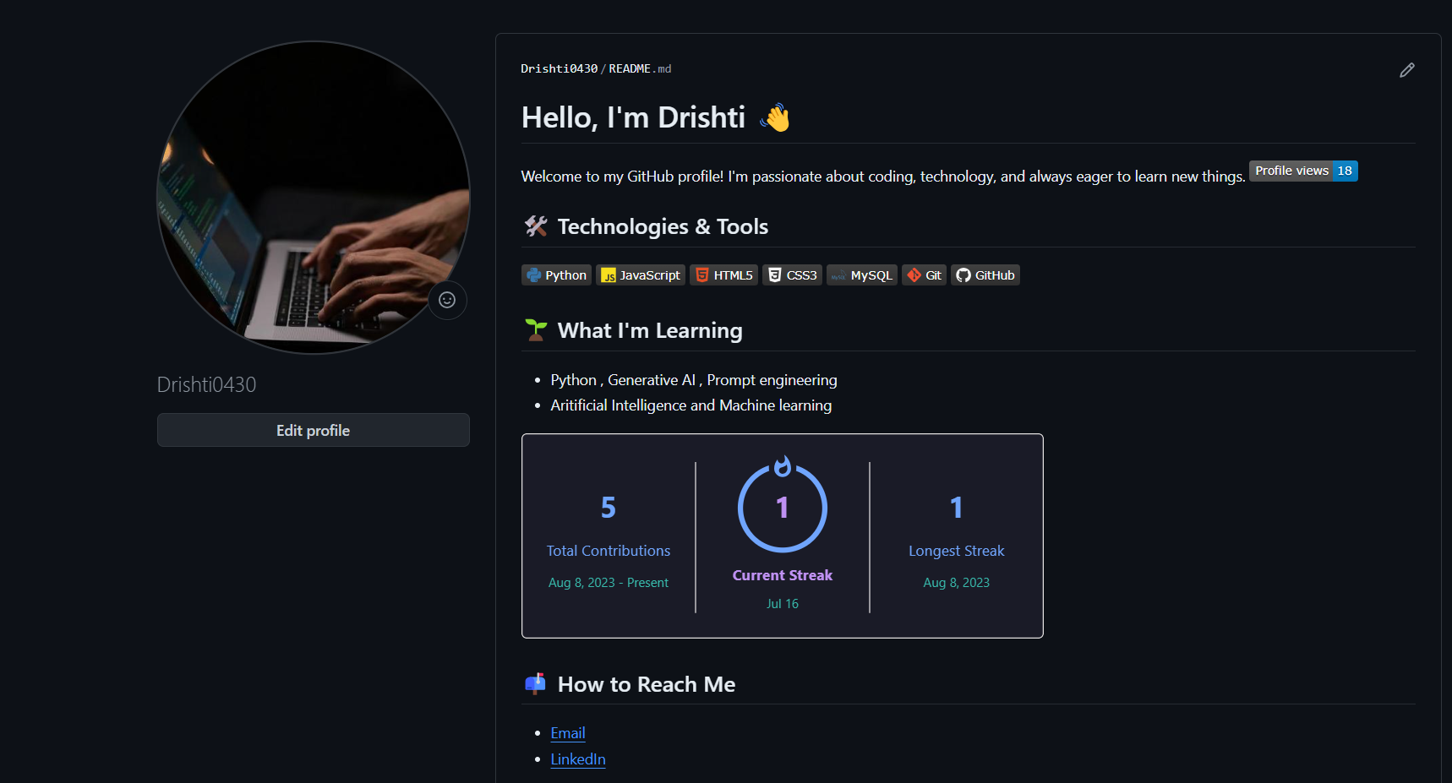

Slide 10
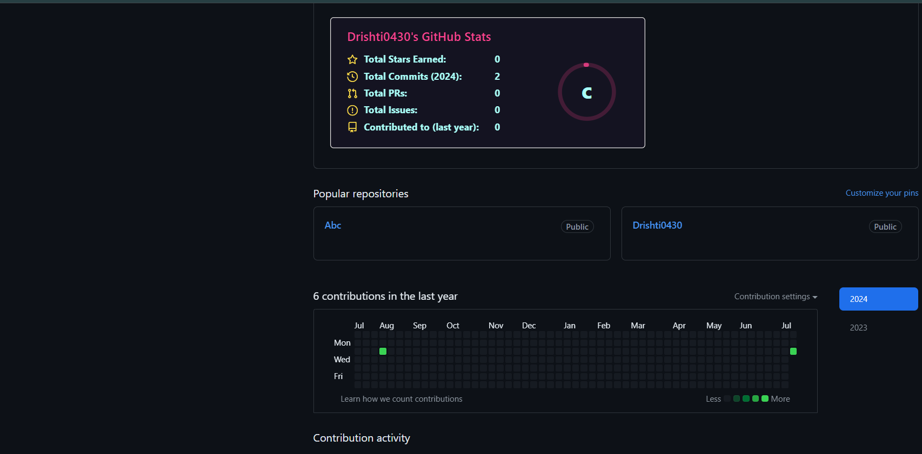

Slide 11
Thankyou

